Slide 1

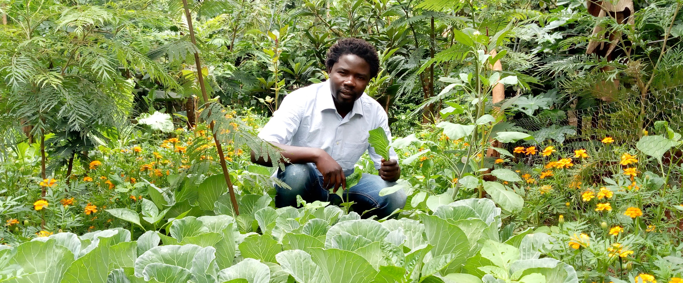



Organizer
Lecture
Permaculture in Kenya
Join the real food revolution!
Philip Munyasia from Kenya presents in Europe his self-help project OTEPIC, founded in 2008.
Sustainable self-feeding in 4 gardens
Caring 22 orphans, drinking water for 2,000 people
Education Seminar Center
Future A peace village is being built
MO 15th of month, 2023 19 h
Event location
Street 5, 12345 City
Supporter
Language: EN
Free entry
Donations are requested
Otepic.org

Slide 2
Organizer
Lecture
Permaculture in Kenya
Join the real food revolution!
Philip Munyasia from Kenya presents in Europe his self-help project OTEPIC, founded in 2008.
Sustainable self-feeding in 4 gardens
Caring 22 orphans, drinking water for 2,000 people
Education Seminare center
Future A peace village is being built
MO 15th of month, 2022 19 h
Event location
Street 5, 12345 City
Supporter
Language: EN
Free entry
Donations are requested
Otepic.org

